Slide 1
Global crime analysis
Presented by:
Angelica
Juan
taryn

Slide 2
Contents
Introduction
Project Management
Research Questions
Selected Dataset
Task Breakdown
Web Scrapping
Interactive Visualizations
Takeaways & future directions
Thank you & Questions

Slide 3
In this project, we investigate: - the rates of global theft and cybercrime - determine which countries have the most and fewest incidences of theft and cybercrime - predict which countries will experience the most and least growth in theft and cybercrime rates - ensure the credibility of our dataset and generate visualizations based on our findings using HTML, CSS, JavaScript, Python and ClickUp
introduction

Slide 4
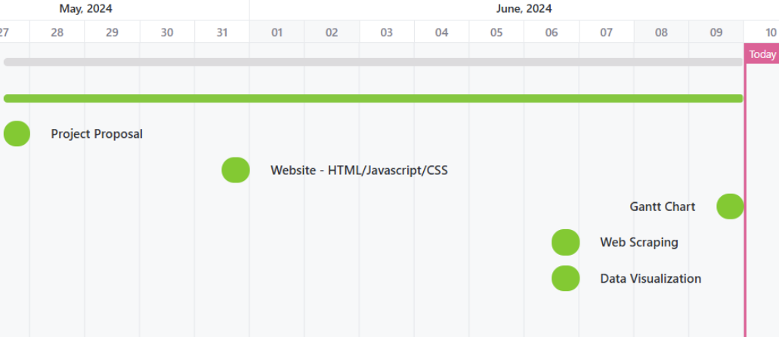
Project management
Clickup gantt chart

Slide 5
Research questions
Which countries have the highest cybercrime rates?
Which countries will have the most growth in cybercrime rates?

Slide 6
SELECted data set the organized crime index
https://ocindex.net/rankings?f=rankings&view=List

Slide 7
Task breakdown
Angelica
Project Management
Web Scraping Design
Juan
GitHub
User Facing Design
Taryn
Web Design
Interactive Visualization Design

Slide 8
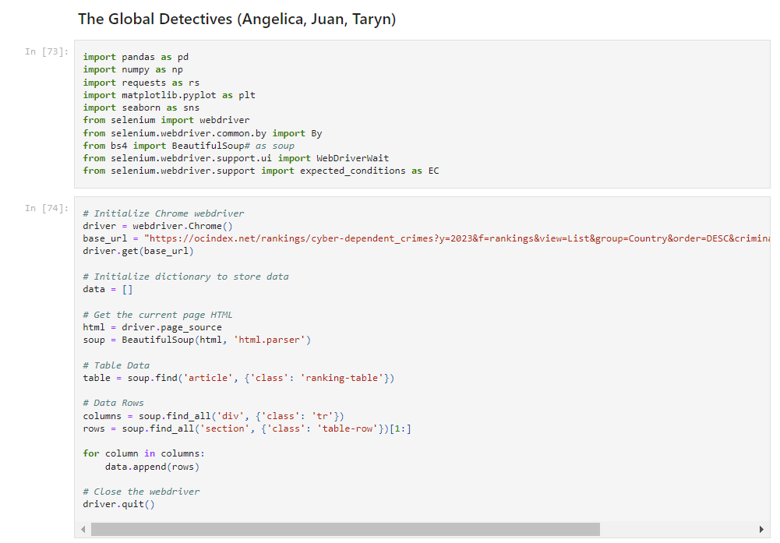
Web SCRAPPING
Python in Jupyter Notebook was used to create a web scrapper that collects data from 2021 and 2023 Cyber-Dependent Crimes and appends the data to a list
Chrome Driver, Selenium, and BeautifulSoup were used to scrape the data from the website
Pandas was used to save data into a Data Frame and in CSV form which was loaded into a NoSQL database

Slide 9
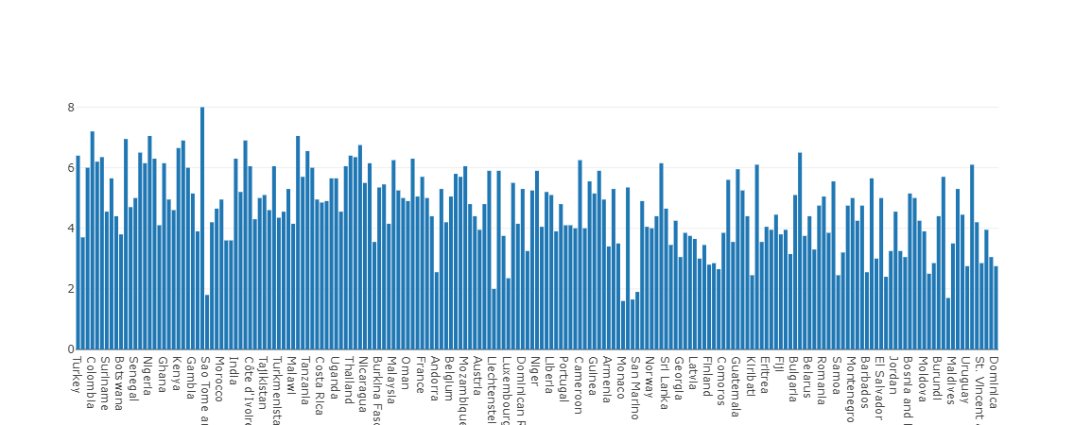
Interactive visualizations
On our website, there is an interactive visualization that allows the user to slide a bar to switch between 2021 and 2023 global cybercrime data
The 2021 data indicates the countries with the highest index that year are: Mexico, Colombia, Myanmar, and Nigeria

Slide 10
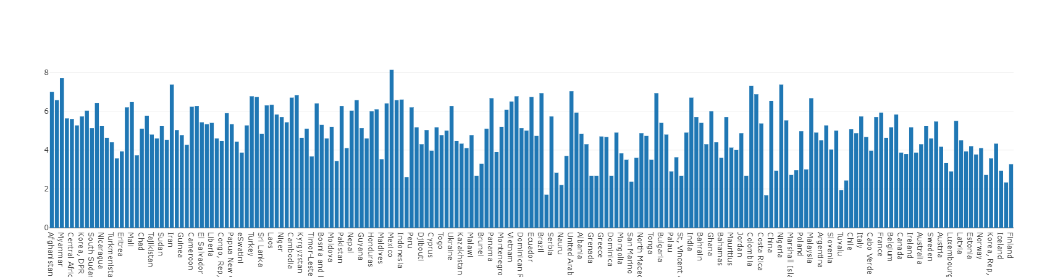
Interactive visualizations
On our website, there is an interactive visualization that allows the user to slide a bar to switch between 2021 and 2023 global cybercrime data
The 2023 data shows the countries with the highest index that year are: Mexico, Myanmar, Iran, Nigeria, and Colombia

Slide 11
TAKEAWAYS & future directions
The main takeaway from this project is Mexico, Colombia, Myanmar, and Nigeria were the top countries with the most cyber-dependent criminal activity in 2021 and 2023
From this data, we predict that these four countries will have the most growth in cybercrime in the future
If we work on this project more in the future, we would like to implement a supervised machine learning model that we can train with the data we collected to come up with a more precise prediction about which countries will see the most growth in cybercrime in the future

Slide 12
THANK YOU
Do you have any questions for us?

